Slide 1
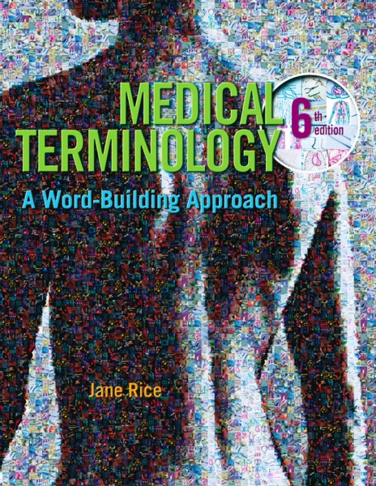
Medical Terminology A Word-Building Approach
Jane Rice, RN, CMA-C
Classroom Response System
Chapter 1 Fundamental Word Structure

Slide 2
Process of being stuck together is known as:
abate
abscess
adhesion
afferent

Slide 3
Process of being stuck together is known as:
abate
abscess
adhesion
afferent

Slide 4
A word element from which other words are formed is called:
combining vowel
prefix
suffix
word root

Slide 5
A word element from which other words are formed is called:
combining vowel
prefix
suffix
word root

Slide 6
Excision means the process of cutting out. The prefix ex- means:
out
to cut
process
in

Slide 7
Excision means the process of cutting out. The prefix ex- means:
out
to cut
process
in

Slide 8
The spreading process of cancer from one area of the body to another area is known as:
abnormal
efferent
malignant
neopathy

Slide 9
The spreading process of cancer from one area of the body to another area is known as:
abnormal
efferent
malignant
neopathy

Slide 10
Which branch of medicine is concerned with diseases of the kidney?
Family Practice
Internal Medicine
Nephrology
Neurology

Slide 11
Which branch of medicine is concerned with diseases of the kidney?
Family Practice
Internal Medicine
Nephrology
Neurology

Slide 12
Abate means to increase.
True
False

Slide 13
Abate means to increase.
True
False

Slide 14
The term for new disease is neopathy.
True
False

Slide 15
The term for new disease is neopathy.
True
False

Slide 16
A lack of color is called palmar.
True
False

Slide 17
A lack of color is called palmar.
True
False

Slide 18
The abbreviation for diagnosis is Dx.
True
False

Slide 19
The abbreviation for diagnosis is Dx.
True
False

Slide 20
An endocrinologist specializes in treating diseases of an allergic nature.
True
False

Slide 21
An endocrinologist specializes in treating diseases of an allergic nature.
True
False

Slide 22
The term prefix means to fix before or to fix to the end of a word.
True
False

Slide 23
The term prefix means to fix before or to fix to the end of a word.
True
False

Slide 24
Cachexia refers to a localized collection of pus.
True
False

Slide 25
Cachexia refers to a localized collection of pus.
True
False

Slide 26
Widespread occurrence of an infectious disease is called an epidemic.
True
False

Slide 27
Widespread occurrence of an infectious disease is called an epidemic.
True
False

Slide 28
The branch of medicine concerned with diseases of the lungs is pulmonary medicine.
True
False

Slide 29
The branch of medicine concerned with diseases of the lungs is pulmonary medicine.
True
False

Slide 30
A trauma surgeon would be responsible for medical repair of traumatic injuries.
True
False

Slide 31
A trauma surgeon would be responsible for medical repair of traumatic injuries.
True
False

Slide 32
Chapter 1 Scenario
You are currently working in a doctor’s office. Most of the people your doctor sees are overweight and are seeking help from your doctor.

Slide 33
What type of physician do you work for?
anesthesiologist
bariatrician
family practitioner
gastroenterologist

Slide 34
What type of physician do you work for?
anesthesiologist
bariatrician
family practitioner
gastroenterologist

Slide 35
What is not a primary concern of bariatrics?
controlling obesity
preventing obesity
stopping obesity
treatment of obesity

Slide 36
What is not a primary concern of bariatrics?
controlling obesity
preventing obesity
stopping obesity
treatment of obesity

Slide 37
The word root bar means
a bar
bar shaped
treatment
weight/pressure

Slide 38
The word root bar means
a bar
bar shaped
treatment
weight/pressure

Slide 39
In the word bariatrician, -ician is which word part?
combining form
prefix
suffix
word root

Slide 40
In the word bariatrician, -ician is which word part?
combining form
prefix
suffix
word root

Slide 41
In the word bariatrics, the word root iatr means:
physician
one who
weight/pressure
treatment

Slide 42
In the word bariatrics, the word root iatr means:
physician
one who
weight/pressure
treatment

