Slide 1
Macromolecules For Identification
Harrison/ Forensics

Slide 2
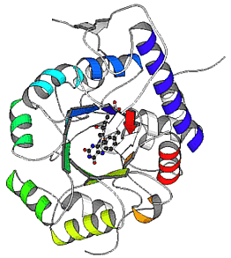
All living things contain organic macromolecules:
Lipids, proteins, carbohydrates and nucleic acids. Characteristic for these organic molecules is that they are made up of only a small number of elements: Carbon, hydrogen, oxygen, and to smaller amounts nitrogen, phosphorus and sulfur.
They are called "macromolecules" because they are very large, containing long chains of carbon and hydrogen atoms and often consists of repeating smaller molecules bonded together in a repeating pattern (polymers).

Slide 3
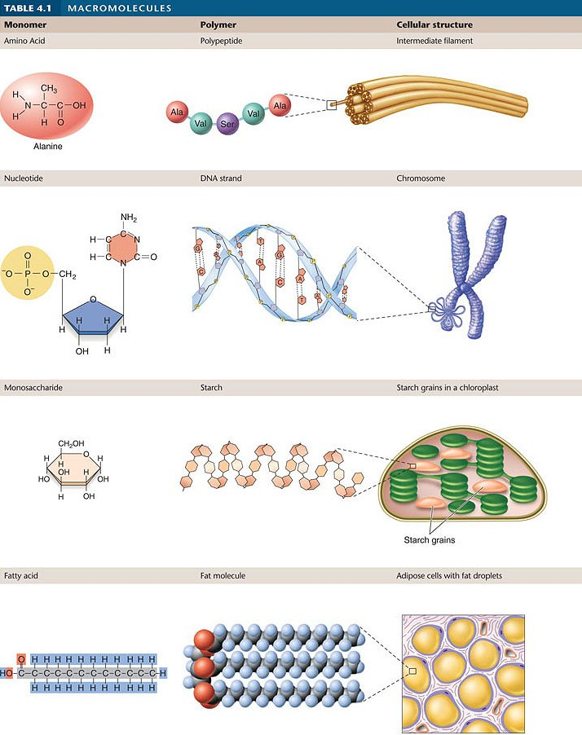
Type of molecule:
Amino Acid
Nucleotide
Monosaccharide
Fatty Acid

Slide 4
Macromolecule building block
Protein
Carbohydrates
Lipids
Nucleic acids
amino acids
monosaccharides
glycerol + fatty acids
nucleotides

Slide 5
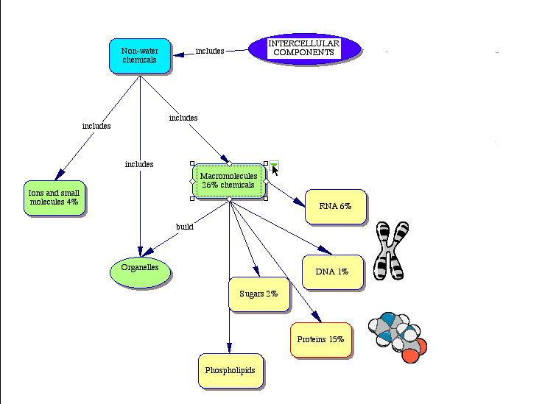

Slide 6
Carbohydrates
Carbohydrates are better known as sugars and starches.
Monosaccharides or simple sugars such as glucose and fructose (C₆H₁₂O₆) function as energy source in cells during cellular respiration and are also used to build cell structures and other organic molecules within the cells.
Disaccharides are composed of two monosaccharides joined together. Sucrose (table sugar) is a disacharide composed of one glucose and one fructose molecule.
Polysaccharides: Are long chains of monosaccharides bond together. Plants store excess glucose in the form of starch, a polysaccharide composed of long chains of glucose. Starches can be found in potatoes, rice, wheat, corn, bananas, peas, beans, lentils, and other tubers, seeds and fruits of plants. Animals (and humans) store excess glucose in the form of glycogen in the liver and muscles.

Slide 7
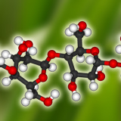
Carbohydrate Molecule

Slide 8
Lipids
A lot of lipids function as long-term energy storage.
One gram of fat stores more than twice as much energy as one gram of carbohydrates.
Lipids are also an important component of the cell membrane. Lipids consist of glycerol and fatty acids "tails". The fatty acid "tails" are long chains of carbon and hydrogen that contribute to the non-polar behavior of fats - they don't mix with (polar) water.

Slide 9
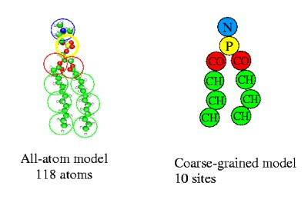
Lipid Molecule

Slide 10
Proteins
Proteins are complex, specialized molecules composed of carbon, oxygen, hydrogen, nitrogen and sometimes sulfur.
The building blocks of proteins are amino acids. There are 20 different amino acids that combine to form polypeptides (proteins).
The different amino acids are similar in structure.
The different amino acids have different side chain, but are otherwise identical.
Proteins have many important roles in organisms. Structural proteins such as collagen or elastin, provide support. Regulatory proteins such as enzymes control cell processes. Proteins also play an important part in the immune system (antibodies), oxygen transport (hemoglobin), movement (muscles) etc.

Slide 11
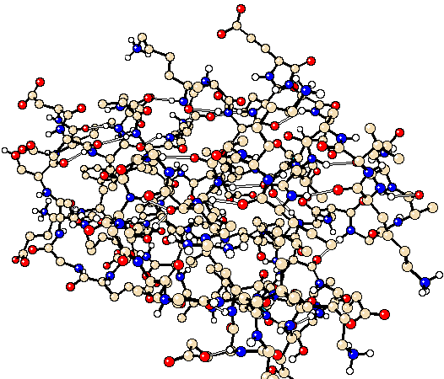
Protein Molecule

Slide 12
Nucleic Acids
are composed of building blocks called nucleotides.
Each nucleotide is made of a sugar molecule, a phosphate molecule and a nitrogenous base.
In DNA (deoxyribose nucleic acid) the sugar is a deoxyribose and the nitrogenous bases are adenine, guanine, cytosine and thymine.
In RNA (ribose nucleic acid) the sugar is a ribose and the bases are adenine, guanine, cytosine and uracil. Nucleic acids carry the genetic information within cells.
(Nucleic acids won't be explored in this lesson. )

Slide 13
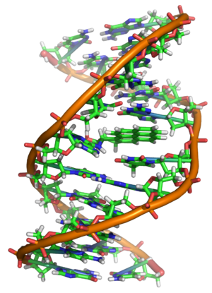
Nucleic Acid Molecules

Slide 14
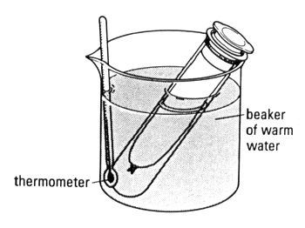
Testing for Macromolecules
You can run different chemical tests to determine what molecules are present.
This is how you determine what is present in stomach or intestinal contents.

Slide 15
Testing for carbohydrates
STARCH
Testing for the presence of starch (complex sugar)
Lugol's reagent (iodine solution) changes from yellowish-brown to dark purple/black.
Add 4 drops of Lugol’s reagent to a small sample
Mix together with toothpick
Observe color for possible change

Slide 16
Sugars
Testing for simple carbohydrates (monosaccharides & disaccharides) Benedict's solution is used
Benedict's solution is a blue colored liquid that contains copper ions. When Benedict's solution & simple carbs are heated, the solution changes to orange red/ brick red.
Add 10 drops of solution & sample to test tube. (and H2O if needed.
Heat with a water bath for 5 minutes.
(heat in test tube, hold with clamp)
Observe for color change

Slide 17
Testing for lipids 2 possible tests
Grease spot test/Brown paper test As we all know from experience, lipids leave translucent spots (grease spots) on unglazed brown paper bags.
Add sample to brown paper
Let sit for at least 1 minute
Remove sample
Let paper air dry (minimum of 5 minutes)
Observe for grease stain that may remain

Slide 18
2nd lipid test option
Sudan Red test Sudan red is a fat-soluble dye that stains lipids red. Using Sudan red can show the amount and the location of lipids.
Add 5 drops of Sudan Red to sample.
Mix with toothpick
Observe for red color appearance
(not recommended for testing red or pink samples)

Slide 19
Testing for proteins
Wright’s Test
Wright’s Blue solution will turn bright pink in presence of proteins.
Add 5 drops of Wright’s solution to sample
Mix with toothpick
Observe for color change

